Slide 1
CI/CD
Fundamentals and benefits of achieving ci/cd for Cloud-based software products

Slide 2
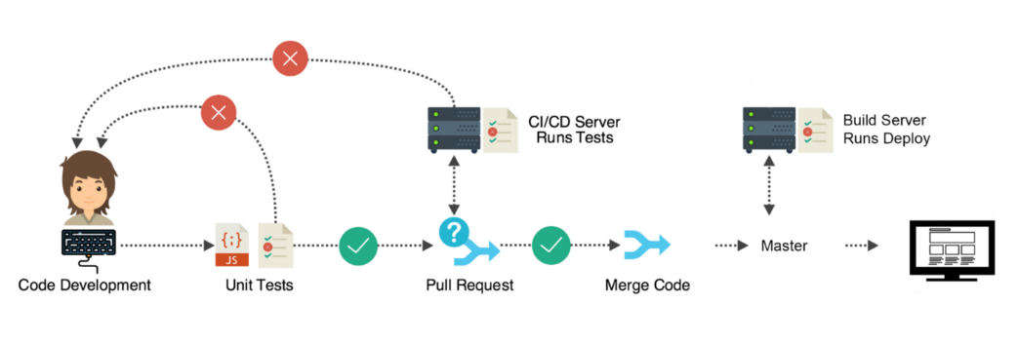
Overview
Fundamentals of CI/CD
Benefits of Continuous Integration (CI)
Benefits of Continuous Deployment (CD)

Slide 3
Fundamentals of CI/CD
Continuous Integration (CI) is the process of combining or merging developers code into the main branch of the repository. Developers used to submit their work at the end of the cycle, resulting in more bugs and long time spend in the testing phase. Integration cost can be reduced using CI as developers will integration from the beginning of the cycle. This approach will save a lot of time and cost.
Continuous Deployment (CD) is a software engineering approach in which the value is delivered frequently through automated deployments. This enable the team to engage with customers and get their feedback from time to time. Any changes or defect found within the application can be handled on time. Also, customer get to follow the progress of their project in real time.

Slide 4
Benefits of CI/CD
Smaller Code Changes
One technical advantage of continuous integration and continuous delivery is that it allows you to integrate small pieces of code at one time. These code changes are simpler and easier to handle than huge chunks of code and as such, have fewer issues that may need to be repaired at a later date. Using continuous testing, these small pieces can be tested as soon as they are integrated into the code repository, allowing developers to recognize a problem before too much work is completed afterward. This works really well for large development teams who work remotely as well as those in-house as communication between team members can be challenging

Slide 5
Benefits of CI/CD Continuation...
Fault Isolations
Fault isolation refers to the practice of designing systems such that when an error occurs, the negative outcomes are limited in scope. Limiting the scope of problems reduces the potential for damage and makes systems easier to maintain. Designing your system with CI/CD ensures that fault isolations are faster to detect and easier to implement. Fault isolations combine monitoring the system, identifying when the fault occurred, and triggering its location. Thus, the consequences of bugs appearing in the application are limited in scope. Sudden breakdowns and other critical issues can be prevented from occurring with the ability to isolate the problem before it can cause damage to the entire system

Slide 6
CI/CD is able to catch compile error after merge leading to developers spending less time on issues related to newly merge code thereby reducing cost in business production.
CI/CD is able to detect security vulnerabilities leading to the prevention of embarrassing & costly security holes thereby avoiding cost in maintaining or fixing the security issue.
CI/CD is able to automate infrastructure cleanup which leads to easy cleanup of infrastructure not being used thereby reducing cost.
CI/CD leads to faster and more frequent development deployment production on need which leads to the release of new features thereby increasing revenue.

Slide 7
Summary of some Benefits
Technical Language | Value | Translation
Catch Compile Errors After Merge | Reduce Cost | Less developer time on issues from new developer code
Detect Security Vulnerabilities | Avoid Cost | Prevent embarrassing or costly security holes
Automate Infrastructure Cleanup | Reduce Cost | Less infrastructure costs from unused resources
Faster and More Frequent Production Deployments | Increase Revenue | New value-generating features released more quickly

